Slide 1
Democratic Leadership Session 11
Course : CB Pancasila
Effective Period : 2017

Slide 2
Student will be able to analyze the problems of democratic leadership
Learning Objectives

Slide 3
Introduction
An organization or community will succeed or fail because of the determination by the leader .
A leader is responsible for the success of the implementation of a job in the organization
Leaders usually more work than talk , more giving examples in life, and more oriented towards subordinates and the public interest in comparison of self-interest .

Slide 4
Leadership
Hughes , RL : Leadership is the best way to understand what leadership is by looking at a variety of ways .
Leadership is an activity to influence the behavior of others so that they will be directed to achieve specific goals . If someone has begun to desire to influence the behavior of other people , then here it is leadership activities have been initiated .

Slide 5
Kusnadi states that : In developing the leadership profile , it is important to pay attention to the position of leader in the organization or community . What assumptions will be held by leaders in the community in the organization in order to work effectively and efficiently

Slide 6
Leadership
Several Differences between a leader and a manager
A Manager | A Leader
Tells | Sells
Plan the details | Sets the direction
Has Objectives | Has vision
Instructs People | Encourages People

Slide 7
Democratic Leadership
Leadership authority is not absolute
Leaders are willing to share authority to subordinates
Policy decisions are made jointly between leaders and subordinates
A two-way communication
Supervision is done fairly
Subordinates given the opportunity to give advices
Tasks to subordinates are more requests than the instruction
Praise and criticism to subordinates are given in balance
There is an atmosphere of mutual trust and respect
Responsibility be shared with subordinate

Slide 8
Discussion
If you become Indonesian leader,
how do you lead democratically

Slide 9
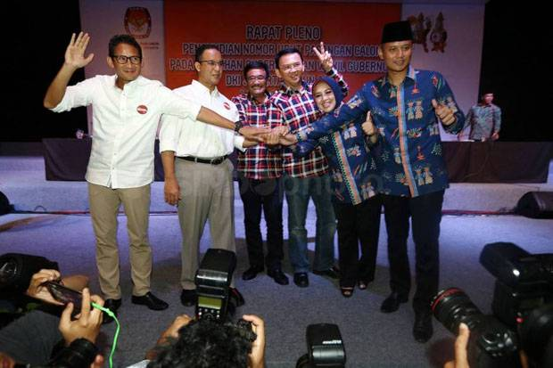
Case Study
Read the article based on the following link ….
And give your opinion
https://nasional.sindonews.com/read/1207598/18/pilkada-jakarta-2017-dan-demokrasi-indonesia-1495559010/13

Slide 10
Question and Answer
?

Slide 11
References
Tim Penulis CB: Pancasila (2014). Diktat Kuliah Character Building: Pancasila. Binus University: CBDC, 000
Kepemimpinan Demokratis:
http://www.slideshare.net/FusuySayi/kepemimpinan-demokratis-25779531
Business Insider - Indonesia:
http://www.businessinsider.co.id/biggest-differences-between-managers-and-leaders-2016-3/?r=US&IR=T#TDcjyJOl5cWxeg4G.97
case study & picture: https://nasional.sindonews.com/read/1207598/18/pilkada-jakarta-2017-dan-demokrasi-indonesia-1495559010/13

